Slide 1
SMART WASTE MANAGEMENT SYSTEM FOR METROPOLITAN CITIES ASSIGNMENT-1
SUBMITED BY:
K. Kiruba Esther
ECE-IV
THAMIRABHARANI ENGINEERING COLLEGE

Slide 2
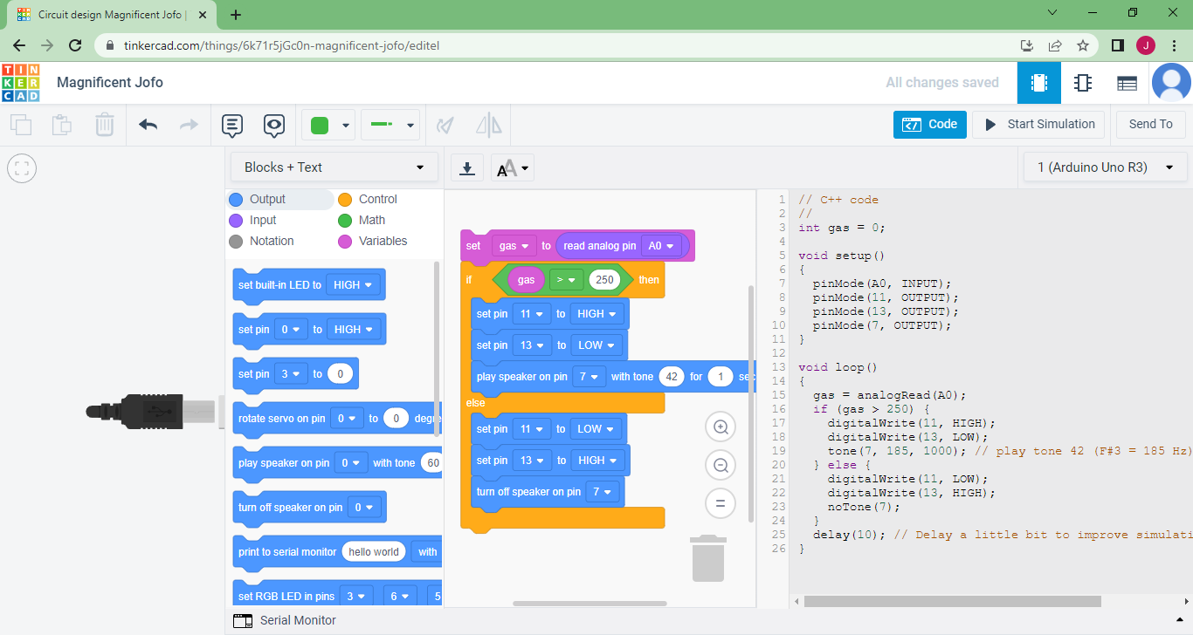

Slide 3
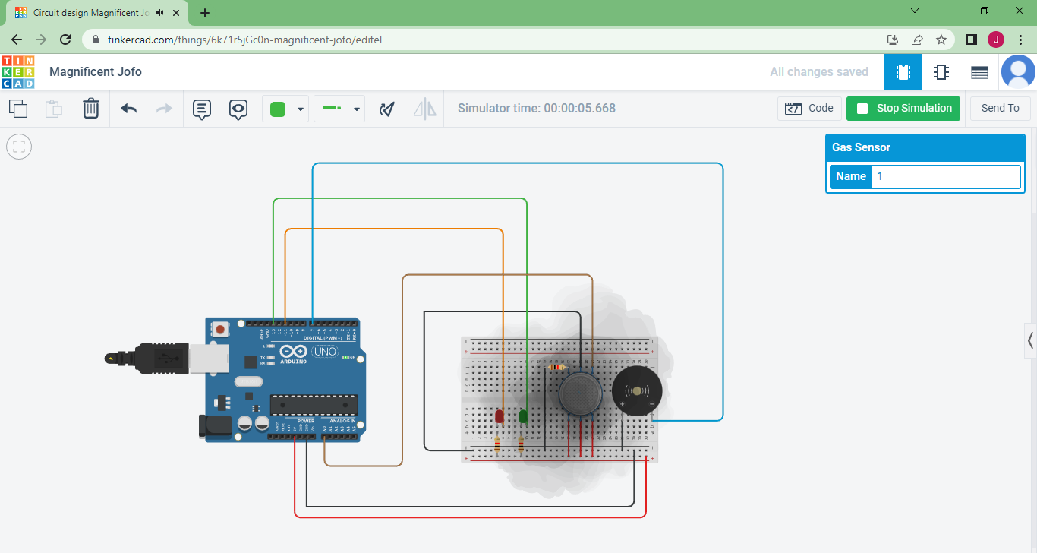

Slide 4
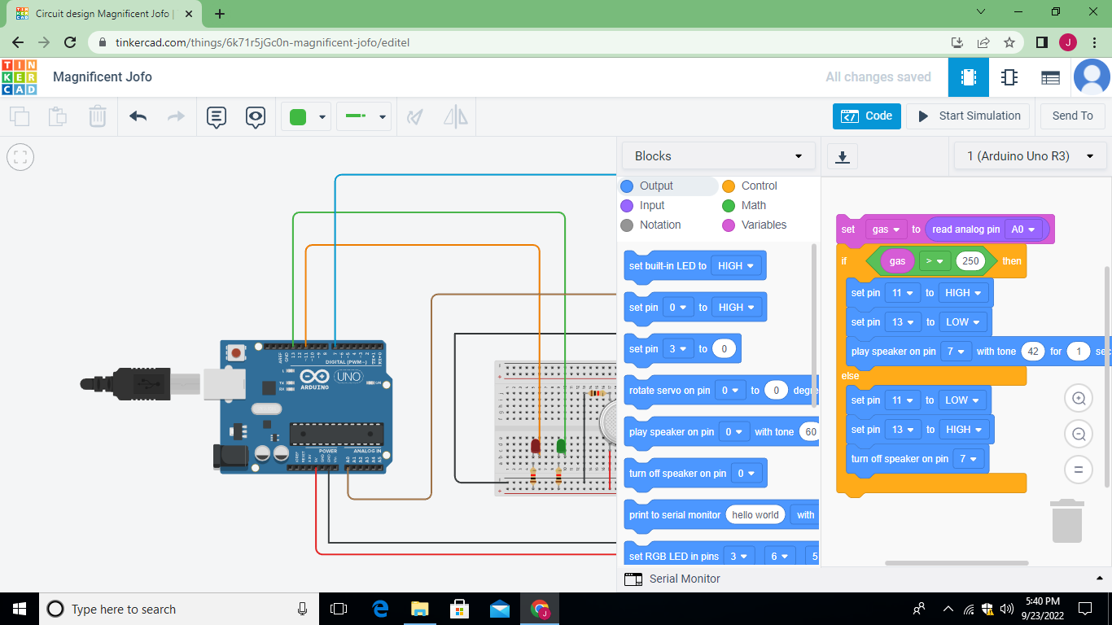

Slide 5
[code]
// C++ code
//
int gas = 0;
void setup()
{
pinMode(A0, INPUT);
pinMode(11, OUTPUT);
pinMode(13, OUTPUT);
pinMode(7, OUTPUT);
}
void loop()
{
gas = analogRead(A0);
if (gas > 250) {
digitalWrite(11, HIGH);
digitalWrite(13, LOW);
tone(7, 185, 1000); // play tone 42 (F#3 = 185 Hz)
} else {
digitalWrite(11, LOW);
digitalWrite(13, HIGH);
noTone(7);

Slide 6
}
delay(10); // Delay a little bit to improve simulation performance
}
[/code]

